Slide 1


OPEN
DATA
SCIENCE
CONFERENCE
@ODSC
Boston | April 30 - May 4, 2019

Slide 2
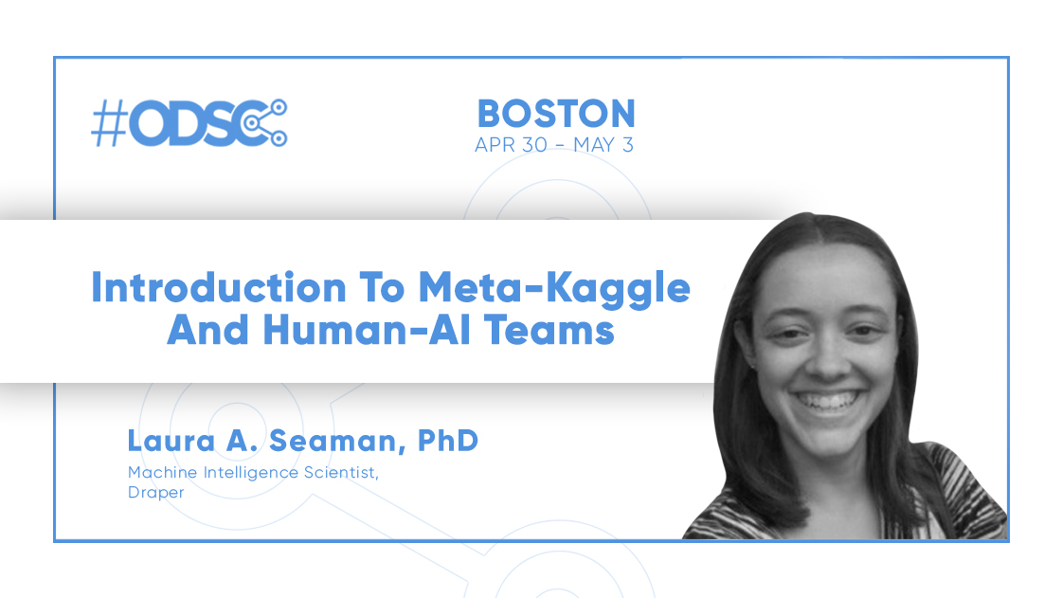
Notes:
Independent not-for-profit research and development company
For more than 80 years Draper has applied exquisite engineering solutions to its customers’ most difficult challenges.
make things that work
bridging the so called valley-of-death
by taking emerging technologies from academa, amping them up with Draper engineering, and applying them to real-world government and commercial customer problems.

Slide 3
Agenda
Project Alloy & Human Machine Teaming
The Technical Approach
Experimental Setup
Instrumented Workspace
AI Teammates
Measuring human machine teamwork
Intro to the meta-Kaggle dataset
Code demo
Notes:
Independent not-for-profit research and development company
For more than 80 years Draper has applied exquisite engineering solutions to its customers’ most difficult challenges.
make things that work
bridging the so called valley-of-death
by taking emerging technologies from academa, amping them up with Draper engineering, and applying them to real-world government and commercial customer problems.

Slide 4
Our motivation
The Motivation : Software engineering/data science is arguably the most important field of the 21st century. Progress will have significant benefits across many fields.
The Enabler : Inherent to these fields are a close relationship between humans and machines. A culture receptive and open to new technologies creates a fertile ground for early adoption of human-AI teaming.
The Science : At a computer, we have the ability to track a multitude of detailed behaviors and interactions. Coupled with technologies built on past efforts, a laboratory fidelity experiment can be achieved ‘in the wild’.
Notes:
Application Examples
Healthcare – predict patients who will decline but need to enable doctors (teams) to understand and make smart choices based on that
pilots – planes fly on autopilot but especially when something goes wrong they need to better communicate the problem.

Slide 5
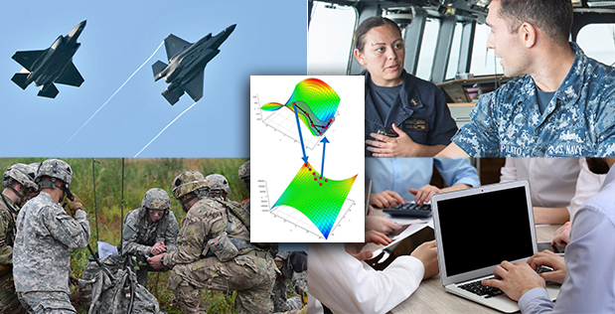
Goal: Learn about human-machine teaming
Agile Teams (A-Teams) is a DARPA project to discover, test, and demonstrate methods for optimizing hybrid teams.
Project Alloy was Draper’s solution to use a machine learning based testbed to
evaluate performance
sense the states of team members and their environment
precisely effect change in hybrid teams
We used a machine learning challenge to better understand how to make hybrid teams more effective.
Notes:
how to effectively work with drones and other smart weapons in teams?
Our platform creates teams, provides AI agents, can record the states of the people and agents, and use that to understand.
Later phases planned to intervene. Do teams perform differently with different levels of AI interaction. Should they talk to all members or just one? Which one?

Slide 6
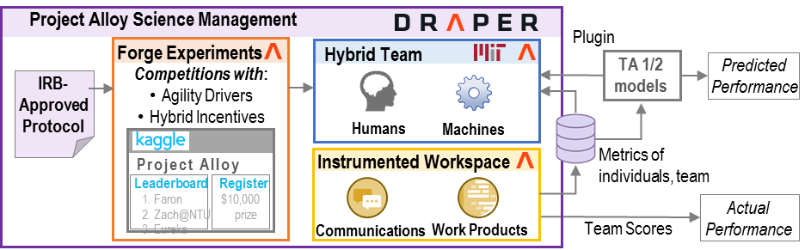
Project Alloy Overview
Project Alloy joins social science and data science to enable agile, hybrid team research
Partner Platform
Online competition – many teams, real-world incentives, tunable difficulty
Instrumented workspace – measure work development & communications
Virtual environment – insert Alloy Agents AIs with selectable capabilities
Notes:
online competitions can have varying goals and difficulty

Slide 7
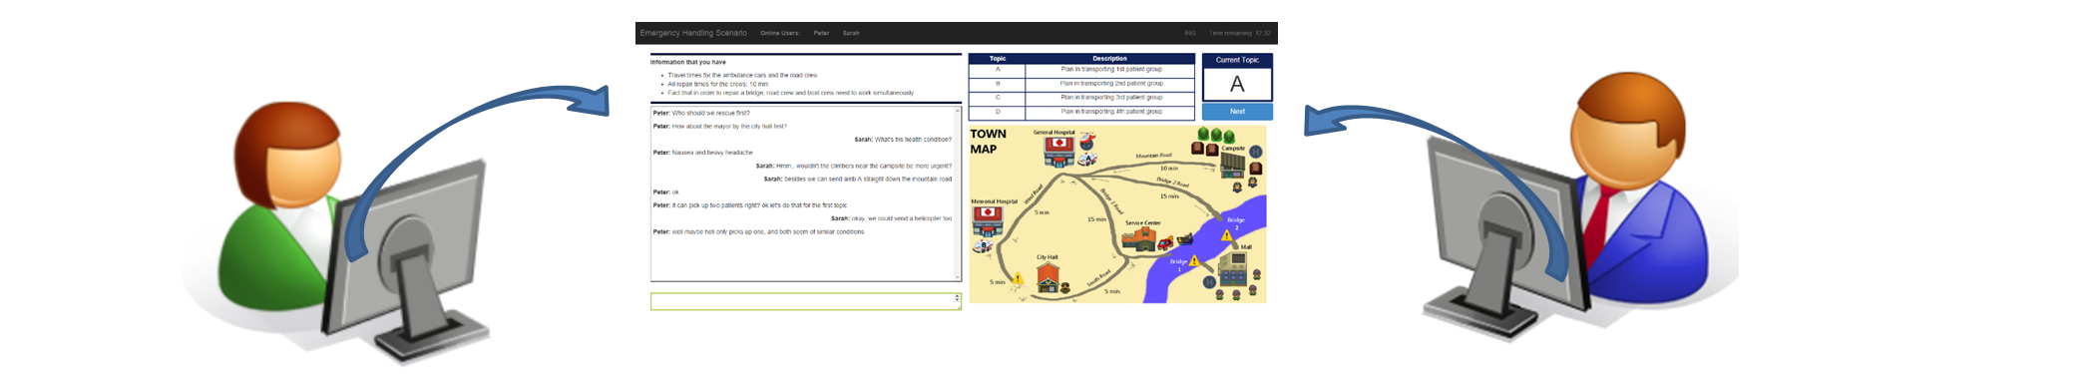
Hybrid Teams need collaboration
True collaborations between humans and machines fail because:
Designers lack experimental platforms.
Closed loop management lacks adequate sensing of the team members and problem space.
Deployment strategies narrowly scope collaboration by limiting machine partners.
By running a ML competition with teams of humans and machines we worked towards eliminating these barriers to breakthroughs in the science of human-machine teaming
Notes:
generally it is hard to measure human teaming
it is hard to measure the effect of an AI, what is it doing and what is the response?
Ais have a small specific role. Not allowed to be interesting and dynamic teammates

Slide 8
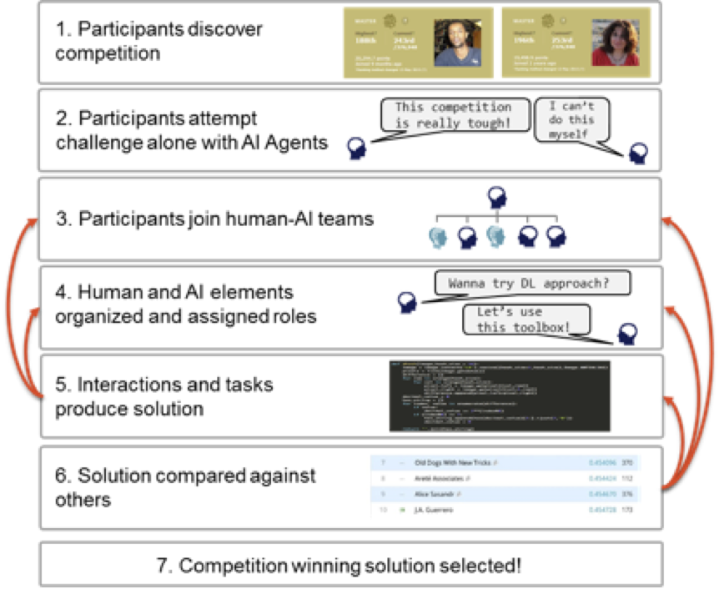
The setup
A neuroscience machine learning challenge pushes participants to collaborate
Machine agents will assist with:
Assigning teams
Checking code
Testing models
Teams of 3 people based on experiences, language preference, work styles, and more.
Notes:
challenge is hard and benefits from collaboration
loop through different states, planning, working on solution (pre-processing, main model, analysis)

Slide 9
Technical Thrusts
Experiments | Utilize online ML competitions to robustly test hypothesis about teaming
Instrumented Workspace | Develop a test-bed for measuring mixed-human & machine agent teaming
Alloy Agents | Enable rapid prototyping and deployment of machine agents within instrumented workspaces with AI exemplars
Partner Platform

Slide 10
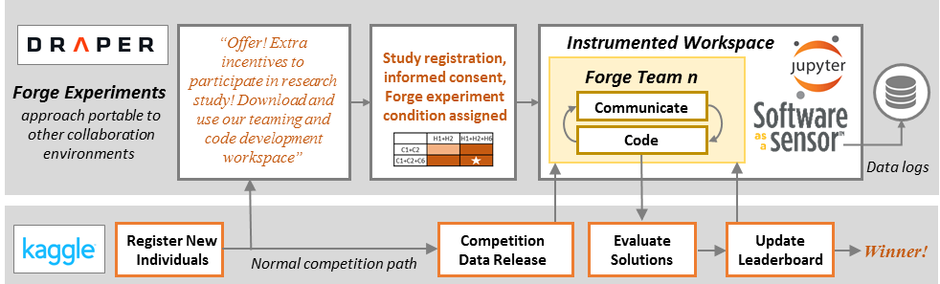
Experiment integrates with competition workflow
Partner platform
Experiments evaluate the performance of human teams with machine partners
Early studies focused on test infrastructure and basic hypotheses about human-machine teaming
Notes:
Everything is the same as a normal competition except users are in our instrumented workspace. It monitors what they do

Slide 11
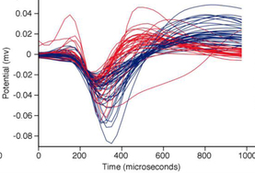
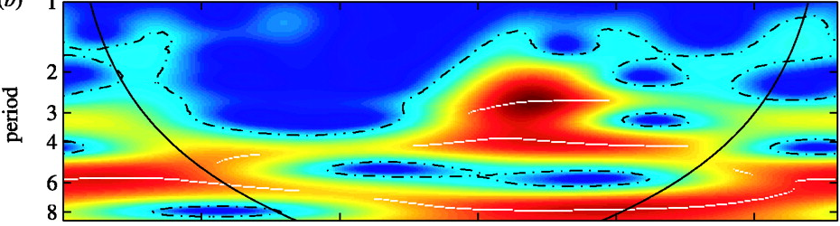
The Challenge: Classification with EEG Data
Challenges were achievable, but could contribute to the realm of the possible in physiological signal processing
Pilots: “Attribution to Source”
Classify which segment of EEG data belongs to which participant/source.
Main Challenge: “Signal Decryption”
Main: Classify the stimuli class presented to participants via EEG signal.
Adversarial: Obfuscate the signal or spoof pre-processing or ML methods for classification.
Counter-Adversarial: Develop new, modified methods for making classification more robust.
Event-Related Potential
Wavelet Power Spectrum
Notes:
original EEG participants have 256 sensors on brain measuring activity
they are show 10 images per second and told to click a button when the focus image is shown (door, stairs, window, etc)

Slide 12
Agenda
Project Alloy & Human Machine Teaming
The Technical Approach
Experimental Setup
Instrumented Workspace
AI Teammates
Measuring human machine teamwork
Intro to the meta-Kaggle dataset
Code demo

Slide 13
Instrumented Workspace Overview
Partner Platform
Hybrid teams work in Instrumented Workspace
Initial teams of 3 people + 2-4 Alloy agents
Human team member participation is voluntary and informed
Measurements provide deeper insights than pre-existing data alone.
Notes:
Instrumented Workspace will gather measurements on how teams interact with each other and develop work products
Higher level individual and team models will be extracted to both power Alloy Agents and novel intelligent machine formalisms

Slide 14

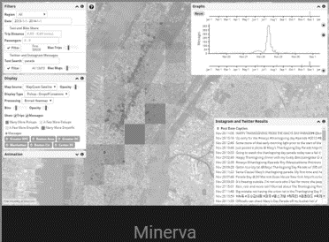
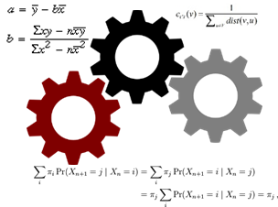

Instrumented Workspace Features
Powered by:
Instrumented Workspace provides…
Software Development Notebook where live code that can be executed
Team Communications – discussion forum and messaging to allow teams to discuss the problem or share code
Privacy and transparency by providing visibility into gathered information to our informed, voluntary research study participants
<hover>
UserALE logs low-level user actions within Instrumented Workspace
3
<pan>
2
1,3
<scroll>
1
4
Analytics extract higher level individual and team behaviors
Alloy Agent API provides data to AIs, and controls to effect change in workspace

Slide 15
Alloy Agents Overview
Partner Platform
Alloy Agents assist human teammates in several roles
Team architect provides user matching
Artifact analysis provides coding support
The Adversarial Agent works with teams to improve their algorithms though adversarial AI.

Slide 16
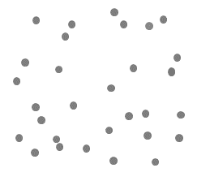
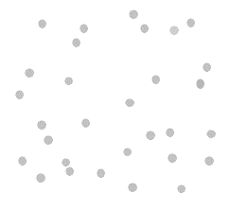
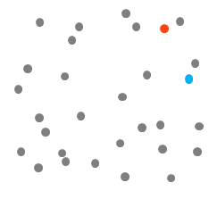
Team Architect
Transform participant surveys into skill and trust scores
Use scores to divide participants into 4 groups
Optimally assign teams within each group
Participant A
(Skill, Trust)
I
Mixed-Integer Linear Program
I
Team 1 A, D, E
Team 2 B, G, H
Standby C, F
Median Skill
II
I
Trust Score
II
Participant Surveys
Demographics
Education
Experience
Personality
Median Trust
III
Teams
&
Standby
(II – IV)
Skill Score
III
IV
IV
Participant B
(Skill, Trust)

Slide 17
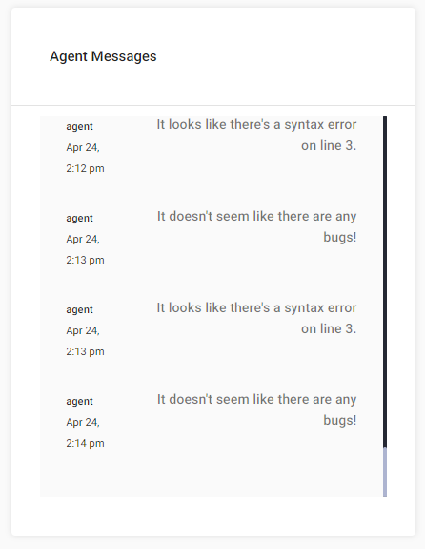
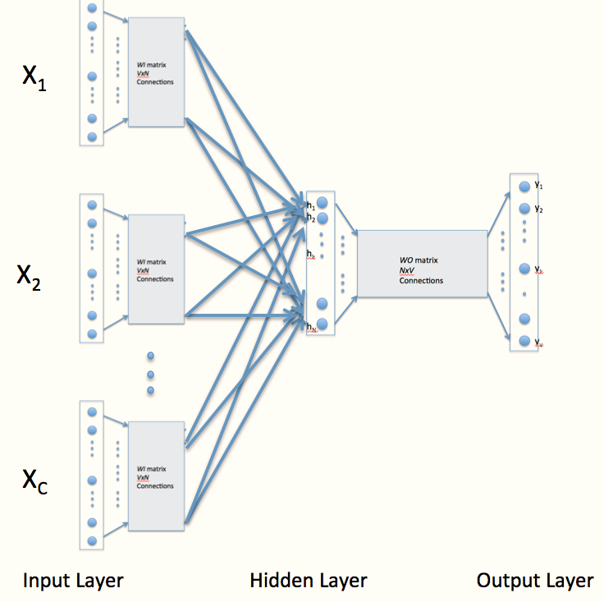
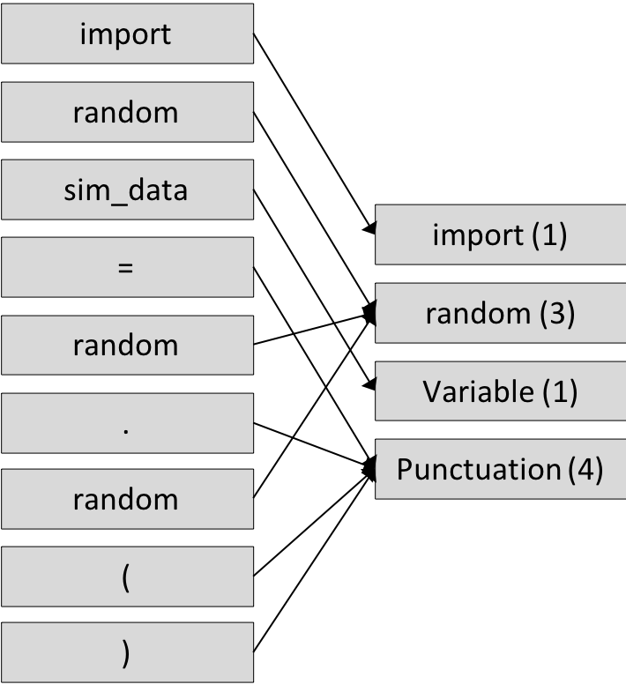
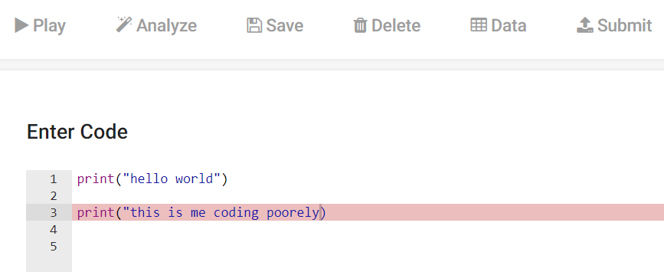
Artifact Analyst
Tokenize Python Syntax
Submit corpus of annotated, tokenized scripts to bag-of-words for classification
Generate message for instrumented workspace
Message Received as Chat
Classification
Verification
Message Received as UI Trigger
Submit predicted errors to Pylint corpus of known errors for verification
Notes:
parse syntax into tokens - remove variable names, numbers, etc
feed into bag of words powering doc2vec to learn if the script will fail or not
provide feedback to participants – more later

Slide 18
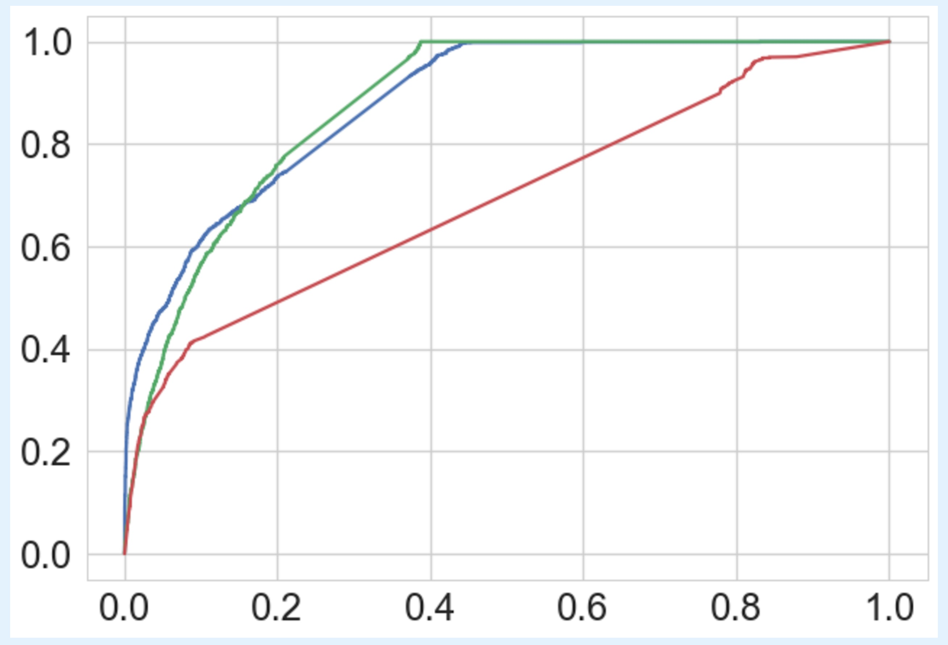
Artifact Analyst Accuracy & Performance
Artifact Analyst
Very fast, 0.001 s per script
Acceptable accuracy
Easily extendable to single line or real-time analysis
Pylint
Slow, ~10 s per script
Acceptable accuracy
Publicly available but not easily adaptable
Combination
Fast, 0.75s / script
Best accuracy
Suitable for real-time analysis
ROC Curve
True positive rate
Pylint
Artifact Analyst
Combination
False positive rate
Notes:
artifact analyst is a doc2vec model that can learn long term dependencies in code, created for paragraph analysis
pylist is public, used for code cleanliness and standards in addition to errors
trained using meta-Kaggle python scripts. had run or failed status

Slide 19
Artifact Analyst
Tokenize Python Syntax
Submit corpus of annotated, tokenized scripts to bag-of-words for classification
Generate message for instrumented workspace
Message Received as Chat
Classification
Verification
Message Received as UI Trigger
Submit predicted errors to Pylint corpus of known errors for verification
Notes:
during deployment, prediction is made by doc2vec
pylint used as verification,
message sent to participants (looks like a syntax error on line 3)

Slide 20
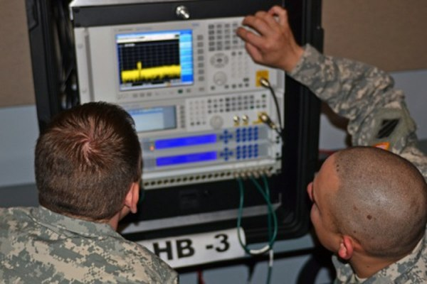
Adversarial Agent : Biometric Warfare Officer
Applying adversarial AI to the electromagnetic biometric spectrum
Classifications
X₁
X₂
X₃
X₄
X₅
EEG / Radio /
Radar Signal
Classification code /
Comms. system / Radar Model
Electronic Warfare Officer
Adversarial signal transform
Replacing Electronic Warfare Officers with AI
Planning
Design and optimization of adversarial examples
Problem Solving
Algorithm research & iterative adversarial testing cycle
Recognition
Algorithm identification and data vulnerability assessment
Language
Communication and team feedback through chat
Notes:
traditionally, electronic warfare officers figure out how to disrupt RF signals.
AdA acts like a penetration tester – looks for vulnerabilities and reports them back to the team
more interesting and interactive role than much AI especially if user interface and interactions are well designed

Slide 21
The Participant – Agent – Platform Workflow
Participants plan / brainstorm
Participants write code
Participants execute code
Participant submits results
Agent tests attacks on participant code
Participant/Agent chat
Agent reports results to participant
Decision Making
Test adversarial signals by using altered data file with same training data and new adversarial test dataset.
Allows testing multiple types of adversarial signals at once
Example Conditions
If the reduction in accuracy is greater than 1/4
If we have not told them about the specific type of vulnerability in > 1 day
Message indicates attack type, effect size, links to helpful websites so participants can improve.

Slide 22
Agenda
Project Alloy & Human Machine Teaming
The Technical Approach
Experimental Setup
Instrumented Workspace
AI Teammates
Measuring human machine teamwork
Intro to the meta-Kaggle dataset
Code demo

Slide 23
Metrics: Quantitatively Describing Teaming
Experimental Measures Produce Data Available to Machine Agents (MAs)
In Situ (Time-Series) | Communication | Performance and Productivity (Time-Series) | Subjective (Intake, Diary)
Workflow: Temporal, sequential dependencies between interface features. | Frequency: # of messages posted | Code “Smell”: Indicators of reusable code—nesting depth, block size, line length, unused code. | Personality: includes Social Facets and Cognitive Style.
Systematicity: seasonality, modal changes in activity | Responsivity: includes response time to last post | Code Conventions: Adherence to specific code conventions (pythonic) | Skill Assessment: includes self/team assessment
Engagement: Transitions between coding and other activity. | Engagement: # of visits to message boards, time spent. | Code Complexity: Effort for shell for the code to run based on vocabulary, length and others. | Team Assessment: Satisfaction with team perf., interpersonal.
Responsivity to MAs: Prediction-Error for human beh. given Mas beh. | Leadership: Temporal, sequential dependencies between chat handles. | Engagement: Frequency and duration of coding inputs | Perf. Attribution: Allocation of team success to team members/agents
Notes:
Draper’s measurement and metrics approach utilized the same data for agents, hypothesis testing, and providing actionable scientific insights.
Measuring these things during the first round of competitions allows building more interesting AI agent in subsequent rounds

Slide 24
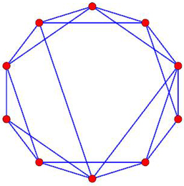
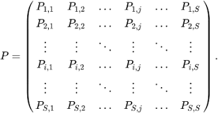
Metrics: Quantitatively Describing Teaming
UserALE.js Log Time-Series
Draw Graph
For each participant, we segment at time-series of their user events (behavior from UserALE.js).
From each window, we build a simple network graph that characterizes user transitions between IW elements.
From each graph, we extract a transition matrix and graph metrics that summarize the relationships between IW elements.
Change-points characterize major changes in the way individuals use the platform.
Extract Metrics
Detect Changes
Graph Metric Time-Series
Notes:
Userals is the logging system of what people do on the platform

Slide 25
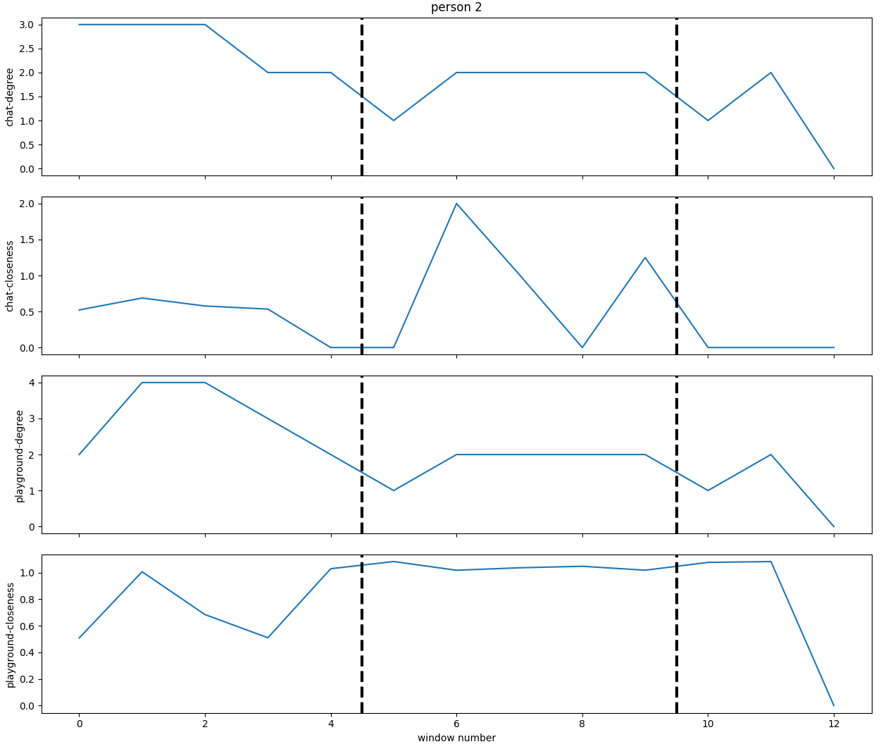
Implementation: Modeling Influence
PRELIMINARY RESULTS
Change Point Time-Series
Code close
Count intra-team chat in the same windows
Message Distro. Time-Series
Window number
P1
Message Structure, by Teammate, Predicts Team Change-Points
P2
P3
Bin and count messages in each window
Total Model Fit: pR² = .38
Log-Odds (P1) = .91, p = .60
Log-Odds (P2) = .61, p = .99
Log-Odds (P3) = .38, p = 1.00
Agent
Use chat metrics to predict change points
Y
=
b
X
+
e
In the test group, changes in platform use related to frequencies of chat.
.
Gives an estimate of teammate influence on individuals

Slide 26
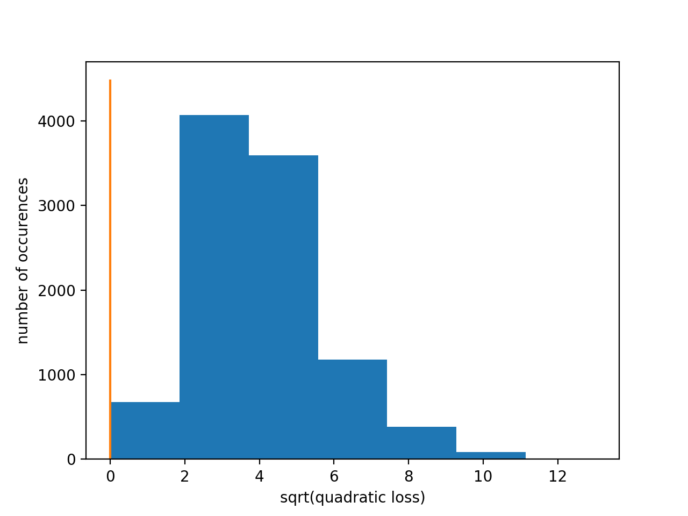
Implementation: Modeling Team Coherence
Change Point Time-Series
PRELIMINARY RESULTS
p < .9⁻⁴
Observed Change Points
Compare observed distances between changes points to random placement
Random
Change Point Time-Series
Change Point Time-Series
We are able to identify patterns of coordination between team-members in their activities on the platform

Slide 27
Agenda
Project Alloy & Human Machine Teaming
The Technical Approach
Experimental Setup
Instrumented Workspace
AI Teammates
Measuring human machine teamwork
Intro to the meta-Kaggle dataset
Code demo

Slide 28
Meta-Kaggle
Kaggle is an online machine learning competition website
In 2015, Kaggle released a dataset containing information on their contests in a set of csv files.
Information includes:
Competition ID, title, description, participant count
Participant ID, performance tier, number of placements
Submission scores on public and private leaderboard
Team memberships
Forum posts
Kernels run including language, author, parent kernel, views
https://www.kaggle.com/kaggle/meta-kaggle

Slide 29
Questions to explore with Meta-Kaggle
Do teams perform better than individuals?
Does releasing one’s code to the community effect the participants performance?
What types of contests are most popular?
How much does prize amount effect contest popularity?
Which language(s) are most popular?
Is there a correlation between language used and performance?
What types of models perform best generally? on a specific type of contest/problem?
Does better coding (following conventions) lead to better results?

Slide 30
Let’s take a look!
https://github.com/laseaman/introduction_to_meta_kaggle

